Slide 1
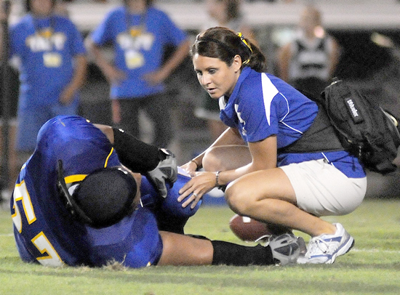
Neurological Disorders Lesson 3.3
Why does applying pressure relieve some of our pain?

Slide 2
Do Now: Review the steps of synaptic transmission with a partner
Ca²⁺

Slide 3
Synaptic Transmission
2. Voltage-gated Ca²⁺ channels open.
4. Ca²⁺ sensitive proteins fuse synaptic vesicles to membrane.
6. NTs bind to postsynaptic receptors.
3. Ca²⁺ flows into cell
5. NTs are released into synaptic cleft
Ca²⁺
1. Action Potential
8. Excess NTs are degraded by enzymes or pumped back into presynaptic cell.
7. Ion channels open on postsynaptic membrane, allowing ions to flow into cell.

Slide 4
Student Model of Pain Pathway

Slide 5
Why would you ever want to decrease the activity of neurons?

Slide 6
How could you decrease the activity of neurons?
Sodium (Na⁺)
Calcium (Ca²⁺)
Chloride (Cl⁻)
Positive
Positive
Negative

Slide 7
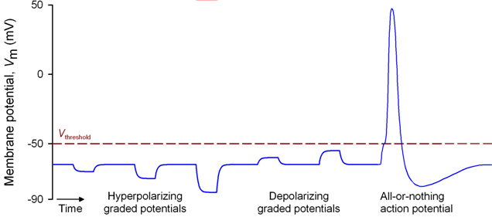
Getting to Threshold
Threshold –
Voltage at which Na⁺ channels open
Inhibitory Postsynaptic potentials (IPSP) caused by entry of negative ions
Excitatory Postsynaptic potentials (EPSP) caused by entry of positive ions

Slide 8
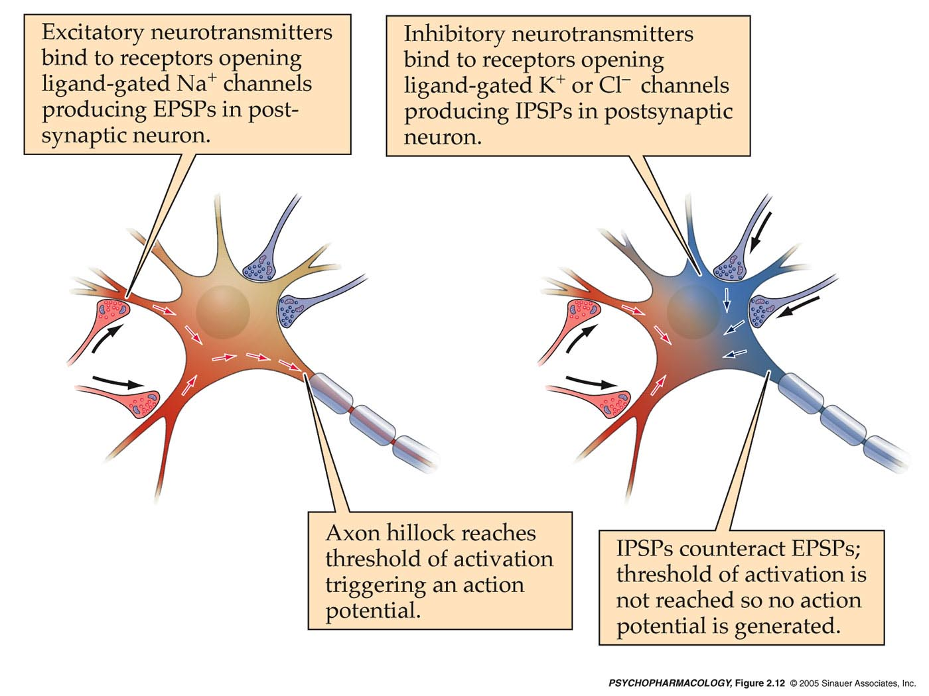
Excitatory and Inhibitory Synapses
Excitatory Synapse:
Neurotransmitters open Na⁺ channels producing EPSPs.
Inhibitory Synapse:
Neurotransmitters open Cl⁻ channels producing IPSPs.
-
+
+
-
+
+
IPSPs encounter EPSPs. Threshold is not reached and no action potential is fired.
Initial segment reaches threshold and action potential is fired.

Slide 9
Decreasing Neuronal Activity: Why do we instinctively apply pressure to something that is painful?

Slide 10
Build the Circuit in the Spinal Cord
Pain neuron
To the Brain
Pressure neuron
Projection Neuron

Slide 11
Build the Circuit in the Spinal Cord
Pain neuron
Projection neuron
+
Pain
Interneuron
To Brain

Slide 12
Add the Pressure Neuron
Pain neuron
Projection neuron
+
Pain
Interneuron
To Brain
Pain
-
Pressure neuron

Slide 13
Depolarization happens when the membrane becomes more positive (inflow of + ions) and the positive charges of the inside matches the positive charges outside of the membrane
This causes action potential/threshold to occur
Excitatory neurotransmitters
Hyperpolarization happens when the membrane becomes more negative (inflow of – ions) and the negative charges of the inside is opposite from the positive charges on the outside
This causes action potential/threshold less likely to happen
Inhibitory neurotransmitters
Action of Neurotransmitters

